Slide 1


Lecture 5
DLI
Continuous Random Variables
连续型随机变量

Slide 2
DLI
Outline
Expectation and Variance of Continuous Random Variables
The Uniform Random Variable
Probability Distributions for Continuous Random Variables
Normal Random Variables
Exponential Random Variables

Slide 3
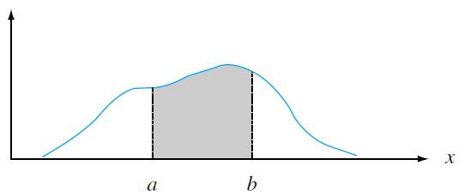
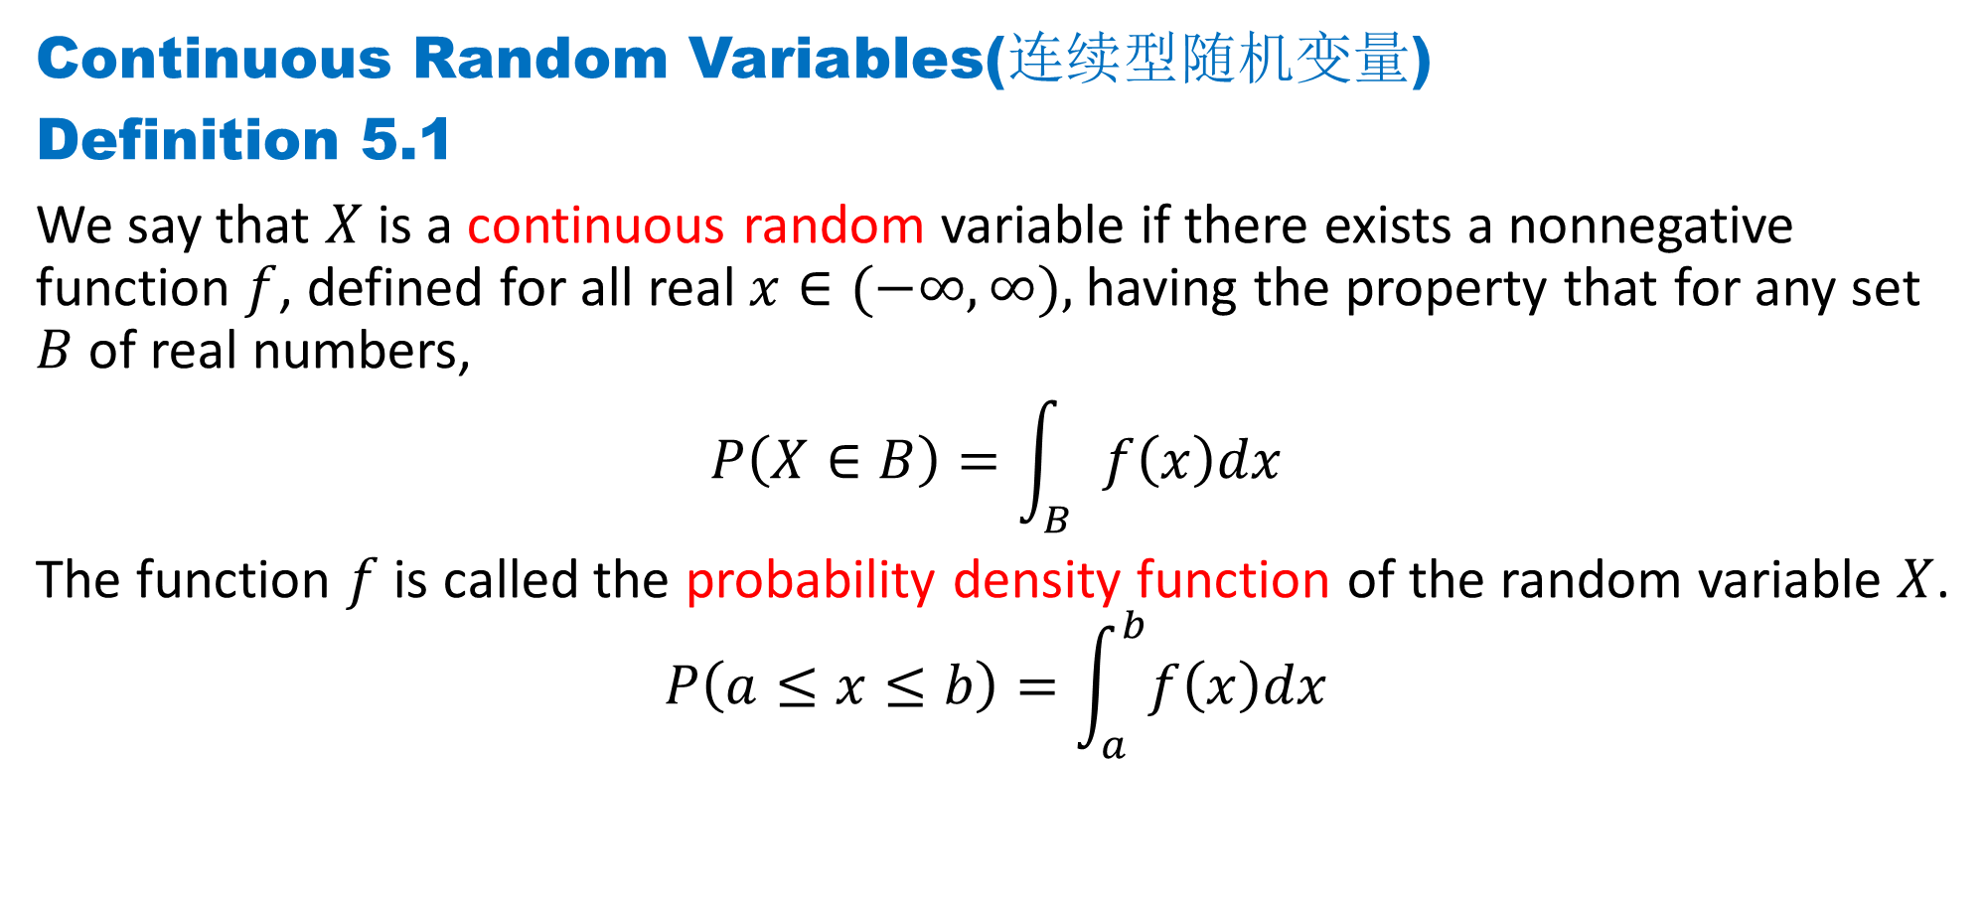
DLI
Continuous Random Variables(连续型随机变量)
Definition 5.1
We say that $X$ is a continuous random variable if there exists a nonnegative function $f$, defined for all real $x∈(−∞, ∞),$having the property that for any set $B$ of real numbers,
$$P\left(X∈B\right)=\int_{B}{f\left(x\right)dx}$$
The function $f$ is called the probability density function of the random variable $X$.
$$P\left(a≤x≤b\right)=\int_{a}^{b}{f\left(x\right)dx}$$

Slide 4
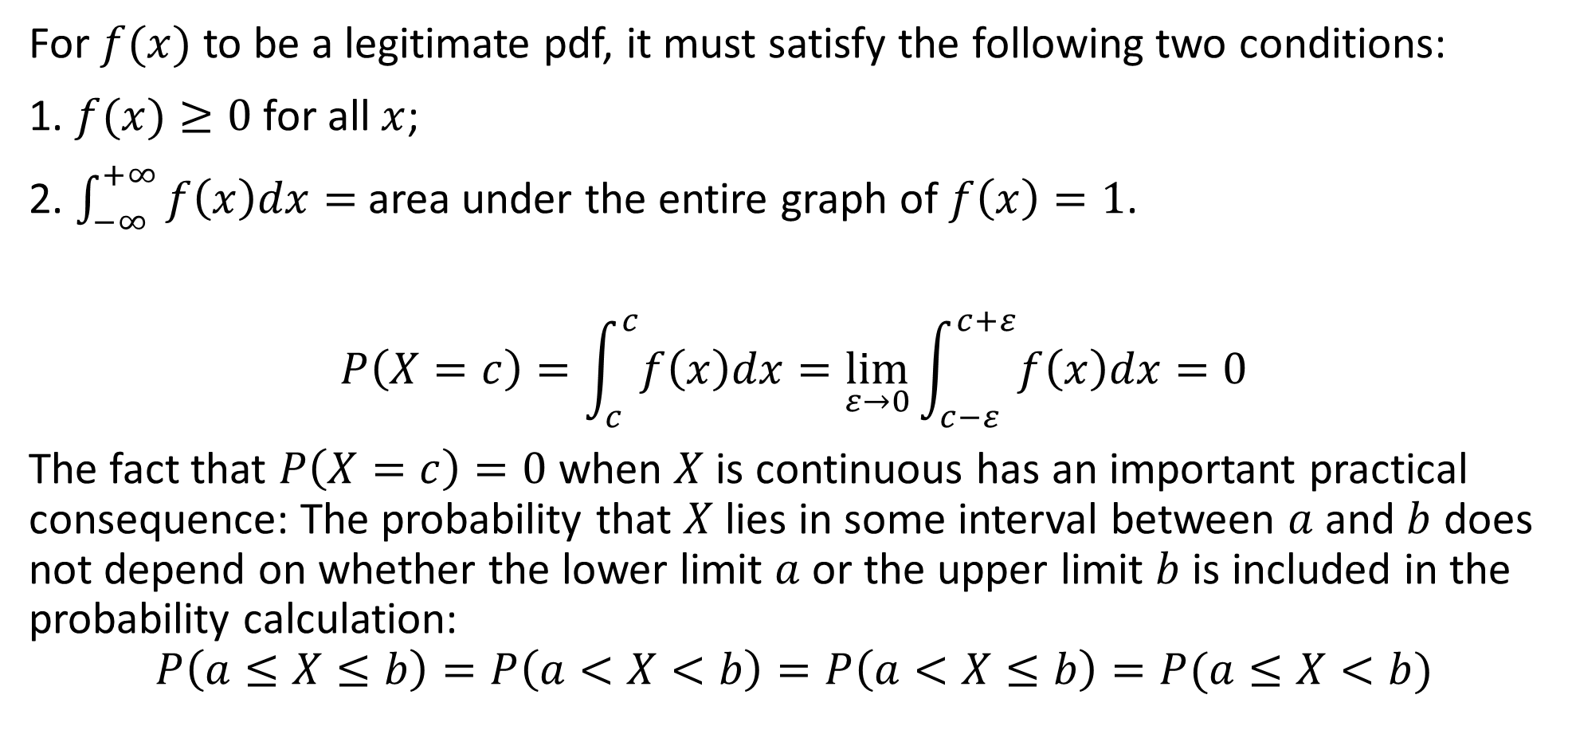
DLI
For $f(x)$ to be a legitimate pdf, it must satisfy the following two conditions:
1. $f(x)≥0$for all $x$;
2. $\int_{−∞}^{+∞}{f\left(x\right)dx}=$area under the entire graph of $f\left(x\right)=1$.
$$P\left(X=c\right)=\int_{c}^{c}{f\left(x\right)dx}=\lim_{ε→0}{\int_{c−ε}^{c+ε}{f\left(x\right)dx}}=0$$
The fact that $P\left(X=c\right)=0$when $X$ is continuous has an important practical consequence: The probability that $X$ lies in some interval between $a$ and $b$ does not depend on whether the lower limit $a$ or the upper limit $b$ is included in the probability calculation:
$$P\left(a≤X≤b\right)=P\left(a<X<b\right)=P\left(a<X≤b\right)=P(a≤X<b)$$

Slide 5
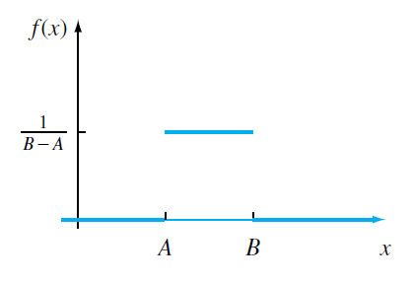

DLI
Definition 5.2 Uniform Distribution （均匀分布）
A continuous rv $X$ is said to have a uniform distribution on the interval $[A, B]$
if the pdf of $X$ is
$$f\left(x;A,B\right)=\left\{\begin{aligned}\frac{1}{B−A}, A≤x≤B \\ 0, otherwise\end{aligned}\right.$$

Slide 6
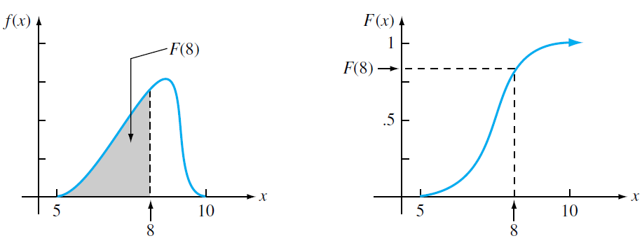
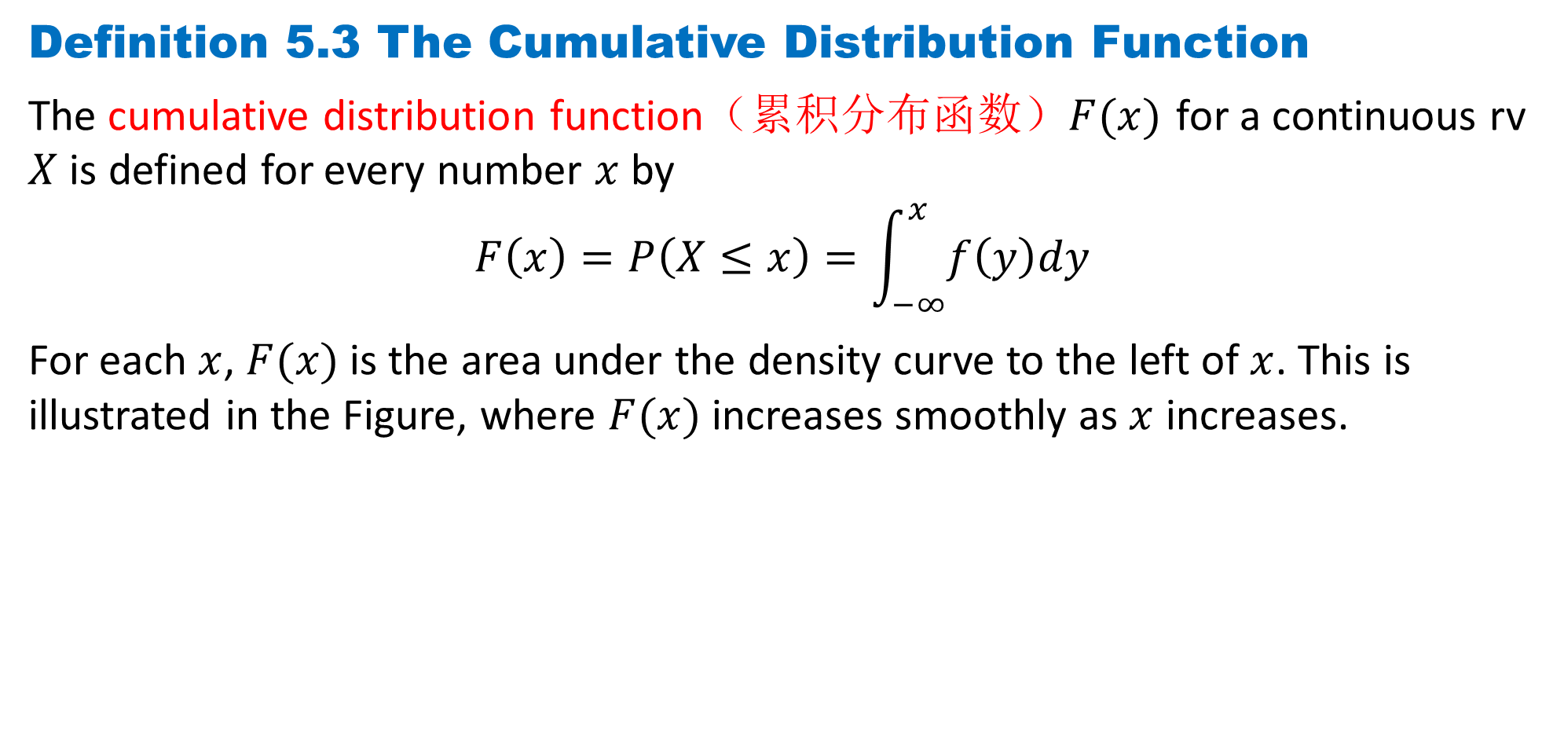
DLI
Definition 5.3 The Cumulative Distribution Function
The cumulative distribution function（累积分布函数）$F(x)$ for a continuous rv $X$ is defined for every number $x$ by
$$F\left(x\right)=P\left(X≤x\right)=\int_{−∞}^{x}{f\left(y\right)dy}$$
For each $x$, $F(x)$ is the area under the density curve to the left of $x$. This is illustrated in the Figure, where $F(x)$ increases smoothly as $x$ increases.

Slide 7
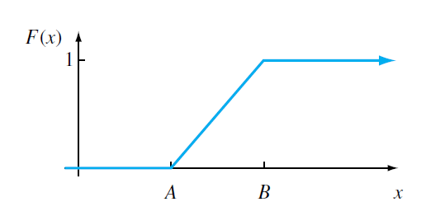

DLI
Example 5.1 The cdf for a uniform distribution
$$f\left(x;A,B\right)=\left\{\begin{aligned}\frac{1}{B−A}, A≤x≤B \\ 0, otherwise\end{aligned}\right.$$
$$F\left(x\right)=P\left(X≤x\right)=\int_{−∞}^{x}{f\left(y\right)dy}=\left\{\begin{aligned}0, x<A \\ \frac{x−A}{B−A}, A≤x≤B \\ 1, x>B\end{aligned}\right.$$

Slide 8
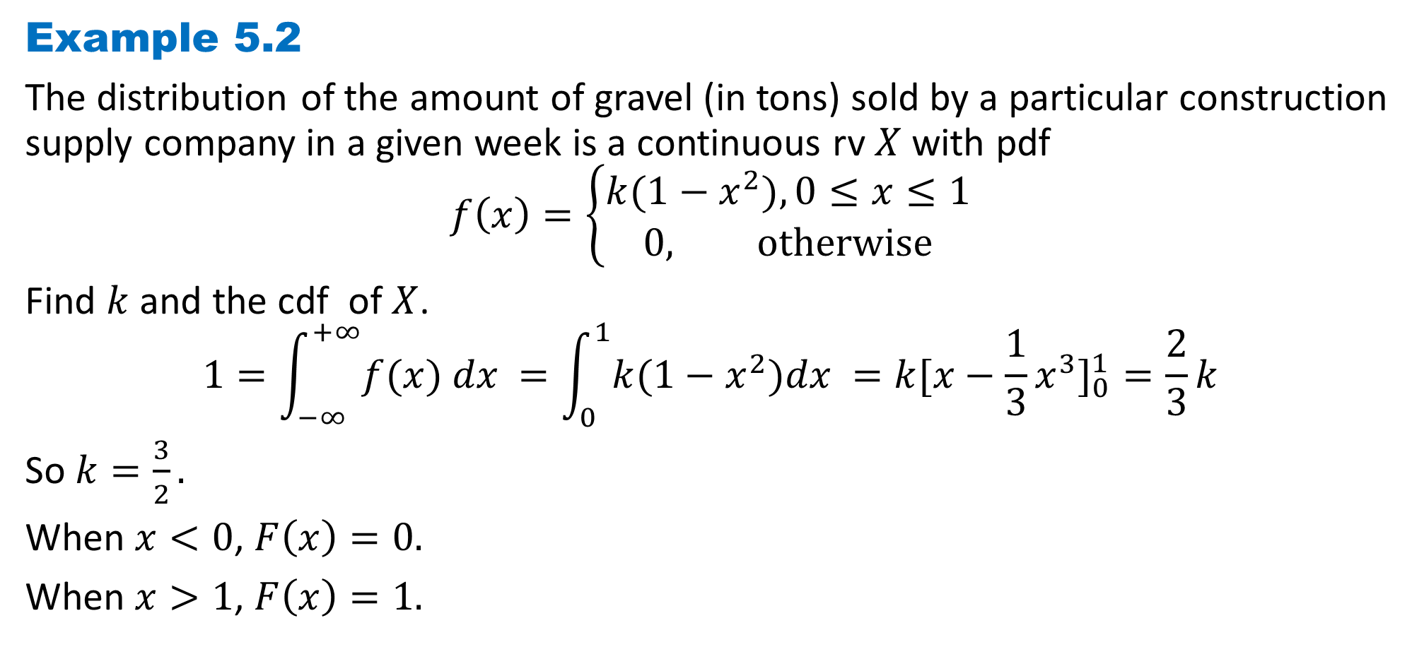
DLI
Example 5.2
The distribution of the amount of gravel (in tons) sold by a particular construction supply company in a given week is a continuous rv $X$ with pdf
$$f\left(x\right)=\left\{\begin{aligned}k(1−x^{2}), 0≤x≤1 \\ 0, otherwise\end{aligned}\right.$$
Find $k$ and the cdf of $X$.
$$1=\int_{−∞}^{+∞}{f(x) dx }=\int_{0}^{1}{k(1−x^{2})dx }=k[x−\frac{1}{3}x^{3}]_{0}^{1}=\frac{2}{3}k$$
So $k=\frac{3}{2}.$
When $x<0$, $F\left(x\right)=0.$
When $x>1$, $F\left(x\right)=1.$

Slide 9
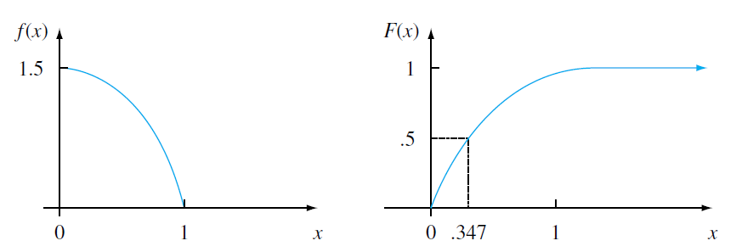

DLI
When $0≤x≤1$,
$$F\left(x\right)=\int_{0}^{x}{\frac{3}{2}(1−y^{2})dy \text{=}\frac{3}{2}(x−\frac{1}{3}x^{3})}$$
So $F\left(x\right)=\left\{\begin{aligned} 0, x<0 \\ \frac{3}{2}\left(x−\frac{1}{3}x^{3}\right), 0≤x≤1 \\ 1, x>1\end{aligned}\right.$

Slide 10
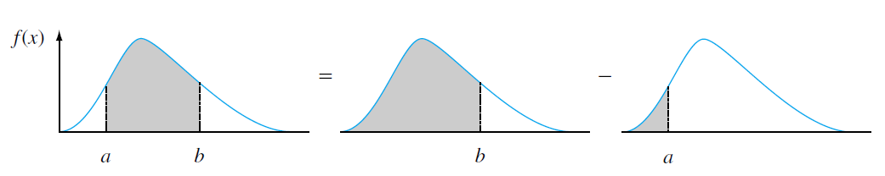

DLI
Using $F(x)$to Compute Probabilities
Let $X$ be a continuous rv with pdf $f(x)$ and cdf $F(x)$. Then for any number $a$,
$$P\left(X>a\right)=1−F(a)$$
and for any two numbers $a$ and $b$with $a≤b$,
$$P\left(a≤X≤b\right)=F\left(b\right)−F(a)$$

Slide 11

DLI
Obtaining $f(x)$ from $F(x)$
Proposition 5.1
If $X$ is a continuous rv with pdf $f(x)$ and cdf $F(x)$, then at every $x$ at which the
derivative $F′(x)$ exists,
$$F′\left(x\right)=f(x)$$

Slide 12
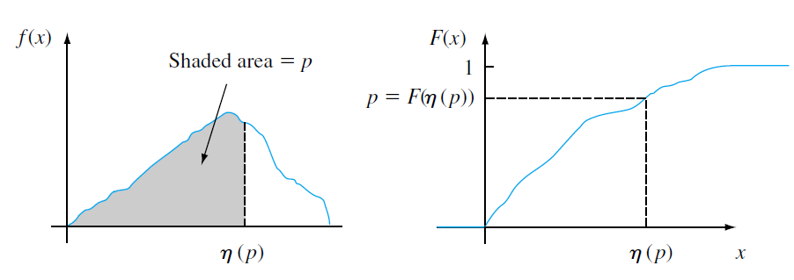

DLI
Definition 5.5 percentile（百分位点）
Let $p$ be a number between $0$and $1$. The $(100p)$th percentile of the distribution of a continuous rv $X$, denoted by $η(p)$, is defined by
$$p=F\left(η\left(p\right)\right)=\int_{−∞}^{η\left(p\right)}{f\left(y\right)dy}$$

Slide 13
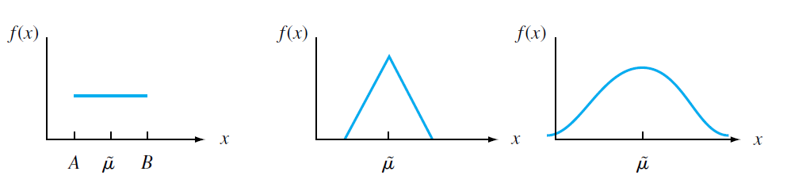

DLI
Definition 5.6 median（中位数）
The median of a continuous distribution, denoted by $\tilde{μ}$, is the $50$th percentile, so satisfies $0.5=F(\tilde{μ}).$That is, half the area under the density curve is to the left of $\tilde{μ}$, and half is to the right of $\tilde{μ}$.
Medians of symmetric distributions

Slide 14

DLI
Expected Values
Definition 5.7
The expected value of a continuous rv $X$ with pdf $f(x)$is
$$μ_{X}=E\left(X\right)=\int_{−∞}^{+∞}{x∙f(x) dx }$$

Slide 15

DLI
Example 5.3
$$f\left(x\right)=\left\{\begin{aligned}\frac{3}{2}(1−x^{2}), 0≤x≤1 \\ 0, otherwise\end{aligned}\right.$$
The expected value of $X$ is
$$E\left(X\right)=\int_{−∞}^{+∞}{x∙f(x) dx }$$
$$=\int_{0}^{1}{\frac{3}{2}x(1−x^{2})dx }$$
$$=\frac{3}{2}[\frac{1}{2}x^{2}−\frac{1}{4}x^{4}]_{0}^{1}=\frac{3}{8}$$

Slide 16
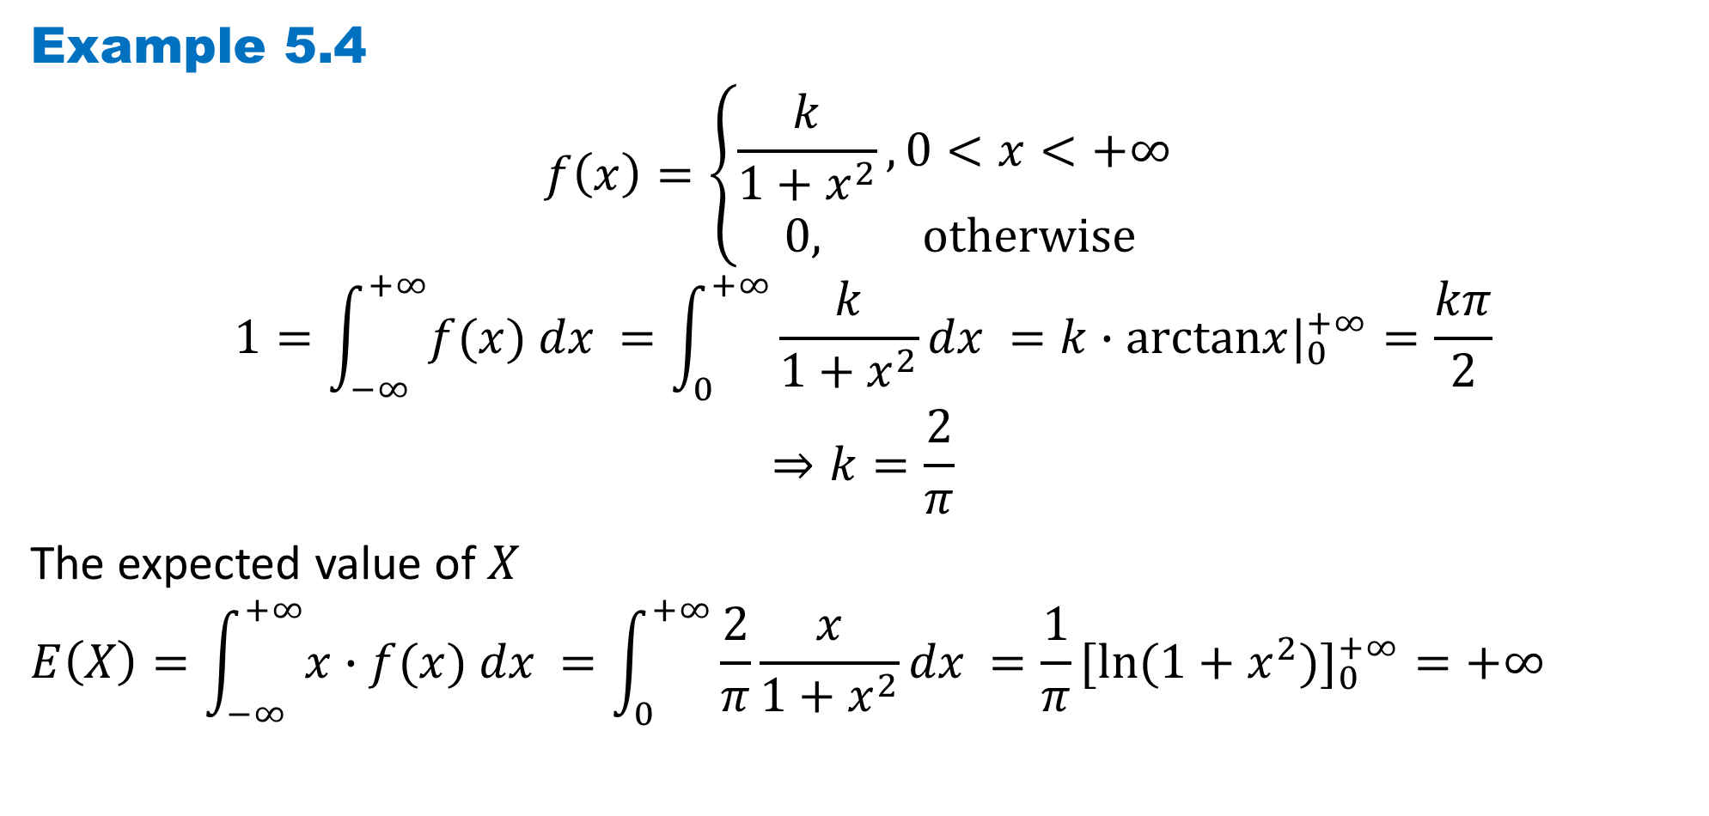
DLI
Example 5.4
$$f\left(x\right)=\left\{\begin{aligned}\frac{k}{1+x^{2}},0<x<+∞ \\ 0, otherwise\end{aligned}\right.$$
$$1=\int_{−∞}^{+∞}{f(x) dx }=\int_{0}^{+∞}{\frac{k}{1+x^{2}}dx }=k∙arctanx|_{0}^{+∞}=\frac{kπ}{2}$$
$$⇒k=\frac{2}{π}$$
The expected value of $X$
$$E\left(X\right)=\int_{−∞}^{+∞}{x∙f(x) dx }=\int_{0}^{+∞}{\frac{2}{π}\frac{x}{1+x^{2}}dx }=\frac{1}{π}[ln⁡(1+x^{2})]_{0}^{+∞}=+∞$$

Slide 17

DLI
Proposition 5.2
If $X$ is a continuous rv with pdf $f(x)$ and $g(X)$ is any function of $X$, then
$$E[g(X)]=\int_{−∞}^{+∞}{g(x)∙f(x) dx }$$
If the $g(X)$ is a linear function $aX+b$,
$$E\left(aX+b\right)=a∙E\left(X\right)+b$$

Slide 18
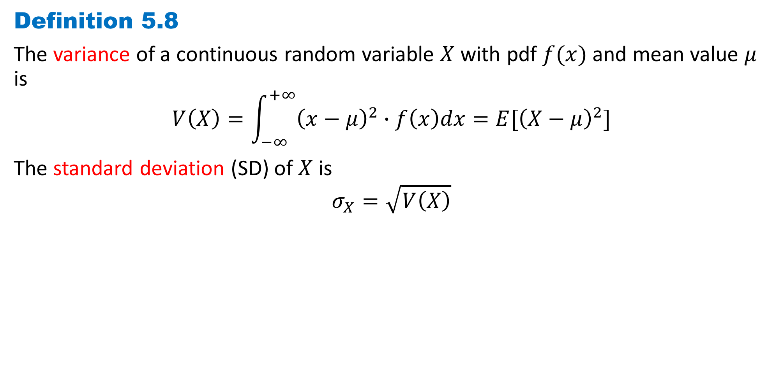
DLI
Definition 5.8
The variance of a continuous random variable $X$ with pdf $f(x)$ and mean value $μ$ is
$$V\left(X\right)=\int_{−∞}^{+∞}{{\left(x−μ\right)}^{2}∙f\left(x\right)dx}=E[{\left(X−μ\right)}^{2}]$$
The standard deviation (SD) of $X$ is
$$σ_{X}=\sqrt{V\left(X\right)}$$

Slide 19
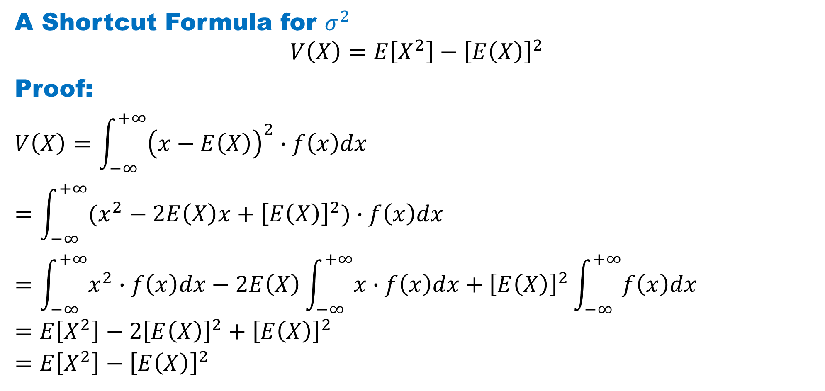
DLI
A Shortcut Formula for $σ^{2}$
$$V\left(X\right)=E\left[X^{2}\right]−{\left[E\left(X\right)\right]}^{2}$$
Proof:
$$V\left(X\right)=\int_{−∞}^{+∞}{{\left(x−E\left(X\right)\right)}^{2}∙f\left(x\right)dx}$$
$$=\int_{−∞}^{+∞}{(x^{2}−2E\left(X\right)x+{\left[E\left(X\right)\right]}^{2})∙f\left(x\right)dx}$$
$$=\int_{−∞}^{+∞}{x^{2}∙f\left(x\right)dx}−2E\left(X\right)\int_{−∞}^{+∞}{x∙f\left(x\right)dx}+{\left[E\left(X\right)\right]}^{2}\int_{−∞}^{+∞}{f\left(x\right)dx}$$
$$=E\left[X^{2}\right]−2{\left[E\left(X\right)\right]}^{2}+{\left[E\left(X\right)\right]}^{2}$$
$$=E\left[X^{2}\right]−{\left[E\left(X\right)\right]}^{2}$$

Slide 20
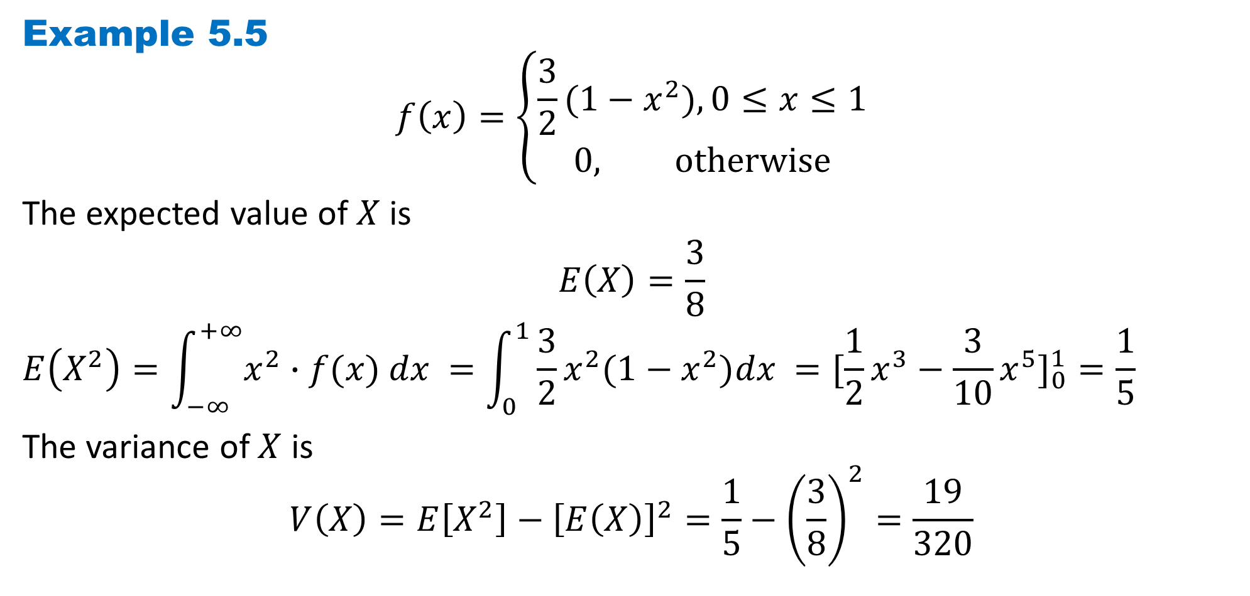
DLI
Example 5.5
$$f\left(x\right)=\left\{\begin{aligned}\frac{3}{2}(1−x^{2}), 0≤x≤1 \\ 0, otherwise\end{aligned}\right.$$
The expected value of $X$ is
$$E\left(X\right)=\frac{3}{8}$$
$$E\left(X^{2}\right)=\int_{−∞}^{+∞}{x^{2}∙f(x) dx }=\int_{0}^{1}{\frac{3}{2}x^{2}(1−x^{2})dx }=[\frac{1}{2}x^{3}−\frac{3}{10}x^{5}]_{0}^{1}=\frac{1}{5}$$
The variance of $X$ is
$$V\left(X\right)=E\left[X^{2}\right]−{\left[E\left(X\right)\right]}^{2}=\frac{1}{5}−{\left(\frac{3}{8}\right)}^{2}=\frac{19}{320}$$

Slide 21

DLI
When $h\left(X\right)=aX+b$, the expected value and variance of $h(X)$ satisfy the same
properties as in the discrete case:
$$E\left[h\left(X\right)\right]=aμ+b$$
and
$$V\left[h\left(X\right)\right]=a^{2}∙σ^{2}$$

Slide 22
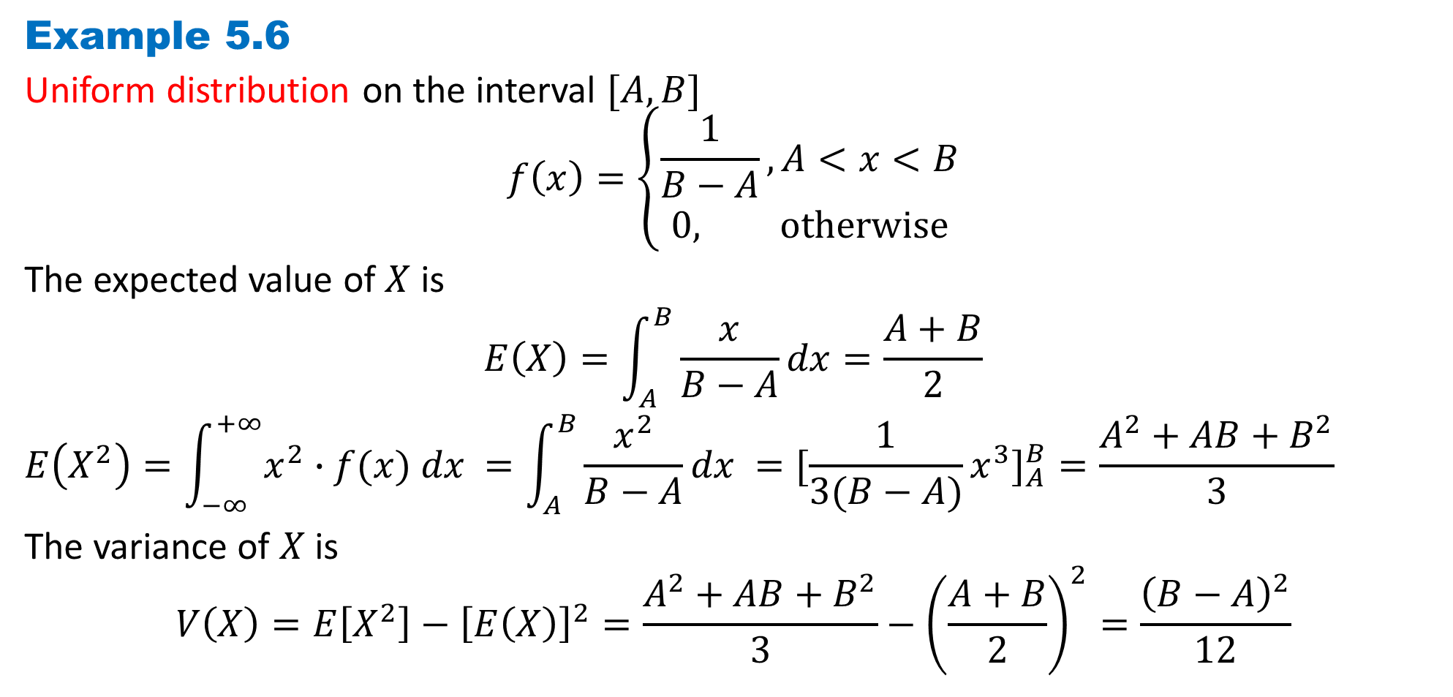
DLI
Example 5.6
Uniform distribution on the interval $[A, B]$
$$f\left(x\right)=\left\{\begin{aligned}\frac{1}{B−A}, A<x<B \\ 0, otherwise\end{aligned}\right.$$
The expected value of $X$ is
$$E\left(X\right)=\int_{A}^{B}{\frac{x}{B−A}dx}=\frac{A+B}{2}$$
$$E\left(X^{2}\right)=\int_{−∞}^{+∞}{x^{2}∙f(x) dx }=\int_{A}^{B}{\frac{x^{2}}{B−A}dx }=[\frac{1}{3(B−A)}x^{3}]_{A}^{B}=\frac{A^{2}+AB+B^{2}}{3}$$
The variance of $X$ is
$$V\left(X\right)=E\left[X^{2}\right]−{\left[E\left(X\right)\right]}^{2}=\frac{A^{2}+AB+B^{2}}{3}−{\left(\frac{A+B}{2}\right)}^{2}=\frac{{\left(B−A\right)}^{2}}{12}$$

Slide 23
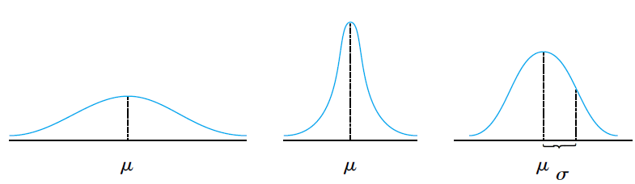
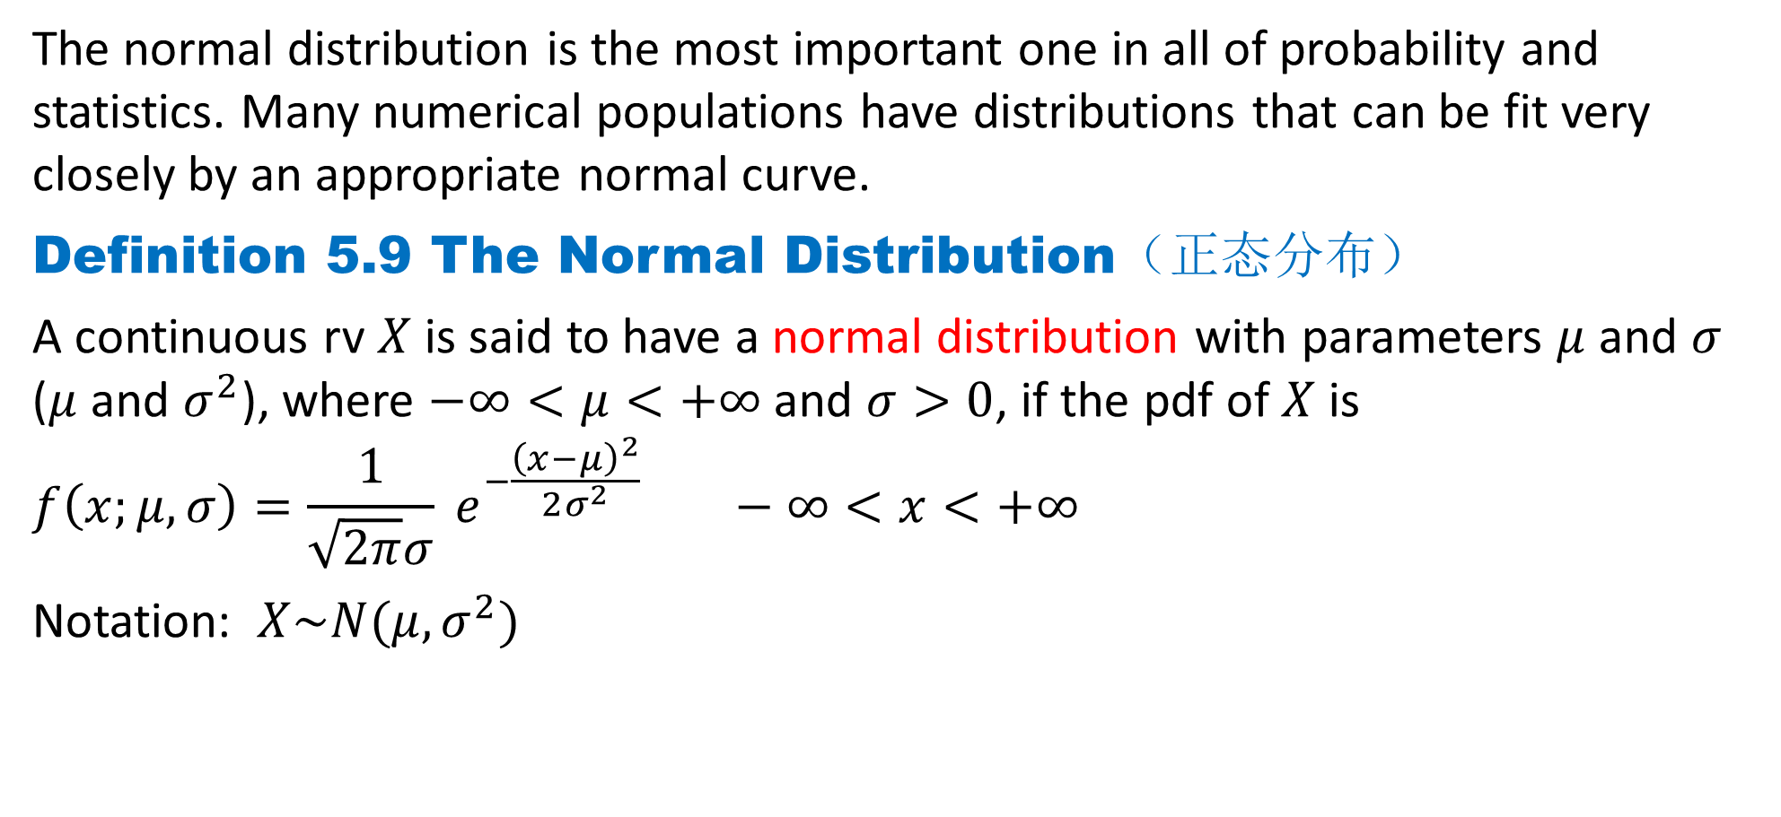
DLI
The normal distribution is the most important one in all of probability and statistics. Many numerical populations have distributions that can be fit very closely by an appropriate normal curve.
Definition 5.9 The Normal Distribution（正态分布）
A continuous rv $X$ is said to have a normal distribution with parameters $μ$ and $σ$ ($μ$ and $σ^{2}$), where $−∞<μ<+∞$ and $σ>0$, if the pdf of $X$ is
$$f\left(x;μ, σ\right)=\frac{1}{\sqrt{2π}σ} e^{−\frac{{\left(x−μ\right)}^{2}}{2σ^{2}}} −∞<x<+∞$$
Notation: $X\sim N(μ,σ^{2})$

Slide 24
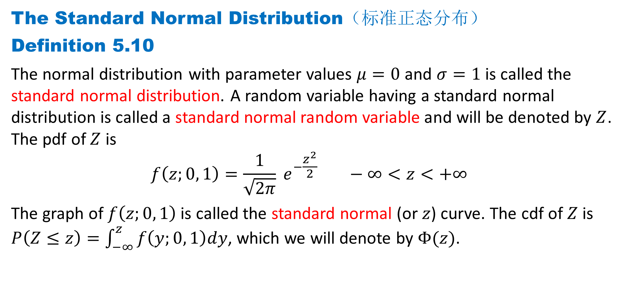
DLI
The Standard Normal Distribution（标准正态分布）
Definition 5.10
The normal distribution with parameter values $μ=0$ and $σ=1$ is called the standard normal distribution. A random variable having a standard normal distribution is called a standard normal random variable and will be denoted by $Z$. The pdf of $Z$ is
$$f\left(z;0, 1\right)=\frac{1}{\sqrt{2π}} e^{−\frac{z^{2}}{2}} −∞<z<+∞$$
The graph of $f\left(z;0, 1\right)$is called the standard normal (or $z$) curve. The cdf of $Z$ is $P\left(Z≤z\right)=\int_{−∞}^{z}{f\left(y;0, 1\right)dy}$, which we will denote by $Φ(z)$.

Slide 25

DLI
$$\int_{−∞}^{+∞}{e^{−\frac{x^{2}}{2}}dx}\int_{−∞}^{+∞}{e^{−\frac{y^{2}}{2}}dy}=\int_{−∞}^{+∞}{\int_{−∞}^{+∞}{e^{−\frac{x^{2}+y^{2}}{2}}dx}dy}$$
$$=\int_{0}^{2π}{\int_{0}^{+∞}{{re}^{−\frac{r^{2}}{2}}dr}dθ}\text{(}\text{Double} \text{Integrals} \text{in} \text{Polar} \text{Form}\text{)}$$
$$=\int_{0}^{2π}{\left({−e}^{−\frac{r^{2}}{2}|_{0}^{+∞}}\right)dθ }$$
$$=2π$$
$$\int_{−∞}^{+∞}{e^{−\frac{x^{2}}{2}}dx}=\sqrt{2π},$$
$$\int_{−∞}^{+∞}{\frac{1}{\sqrt{2π}}e^{−\frac{z^{2}}{2}}dz}=1$$

Slide 26
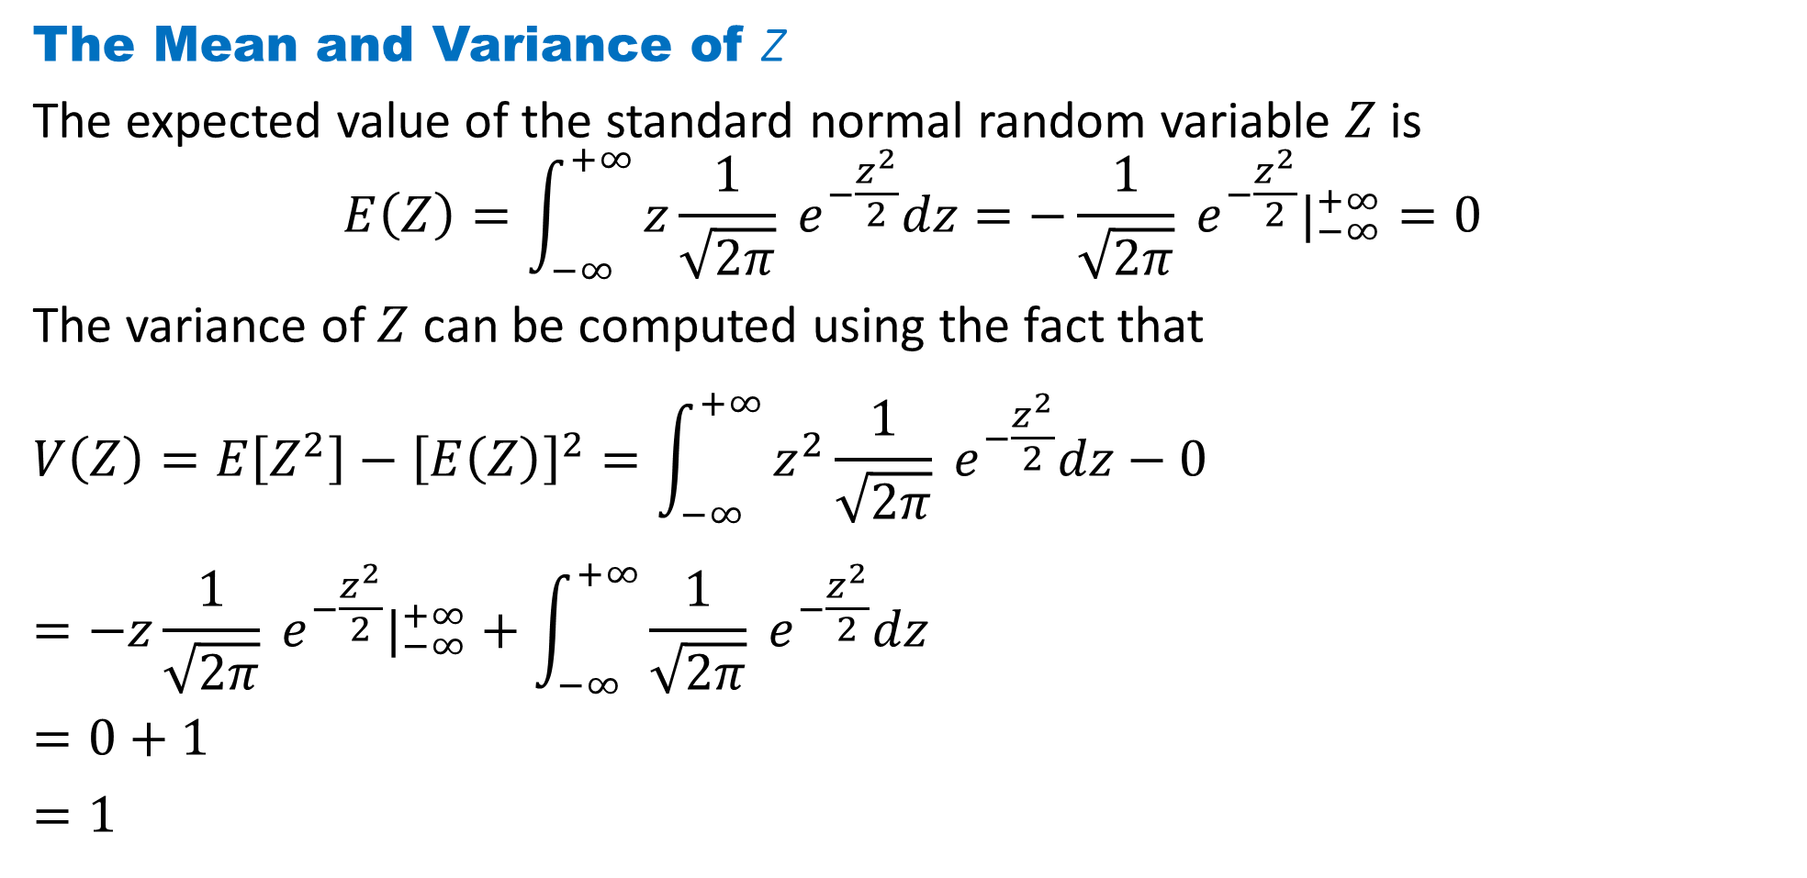
DLI
The Mean and Variance of Z
The expected value of the standard normal random variable $Z$ is
$$E\left(Z\right)=\int_{−∞}^{+∞}{z\frac{1}{\sqrt{2π}} e^{−\frac{z^{2}}{2}}dz}=−\frac{1}{\sqrt{2π}} e^{−\frac{z^{2}}{2}}|_{−∞}^{+∞}=0$$
The variance of $Z$ can be computed using the fact that
$$V\left(Z\right)=E\left[Z^{2}\right]−{\left[E\left(Z\right)\right]}^{2}=\int_{−∞}^{+∞}{z^{2}\frac{1}{\sqrt{2π}} e^{−\frac{z^{2}}{2}}dz}−0$$
$$=−z\frac{1}{\sqrt{2π}} e^{−\frac{z^{2}}{2}}|_{−∞}^{+∞}+\int_{−∞}^{+∞}{\frac{1}{\sqrt{2π}} e^{−\frac{z^{2}}{2}}dz}$$
$$=0+1$$
$$=1$$

Slide 27
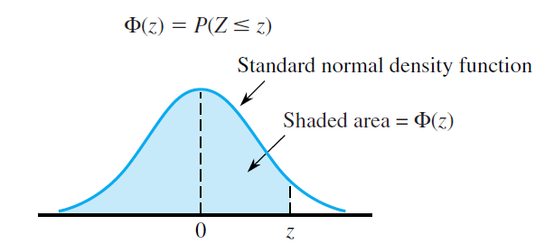
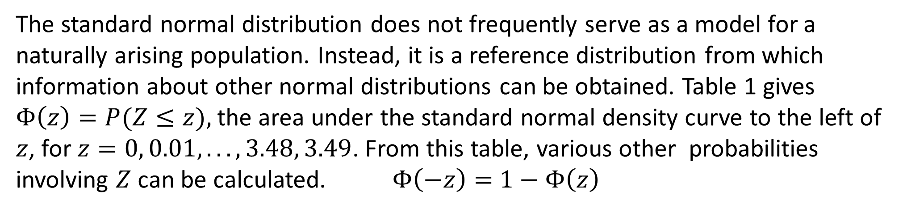
DLI
The standard normal distribution does not frequently serve as a model for a naturally arising population. Instead, it is a reference distribution from which information about other normal distributions can be obtained. Table 1 gives $Φ\left(z\right)=P(Z≤z),$the area under the standard normal density curve to the left of $z$, for $z=0, 0.01, . . . , 3.48, 3.49$. From this table, various other probabilities involving $Z$ can be calculated. $Φ\left(−z\right)=$ $1−Φ\left(z\right)$

Slide 28
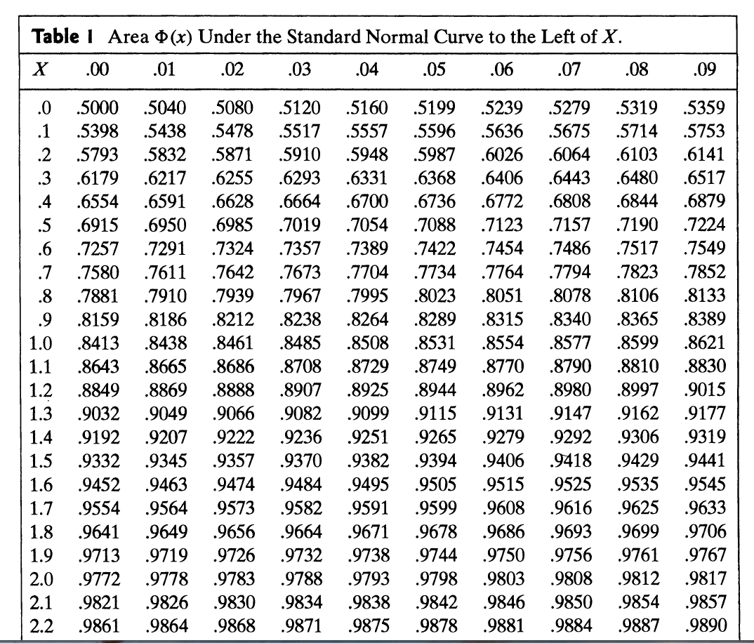
DLI

Slide 29
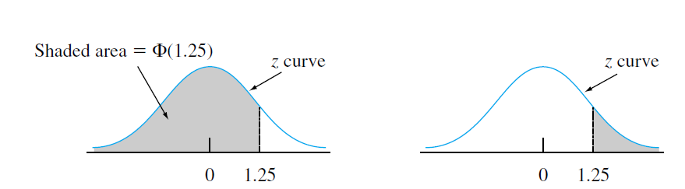
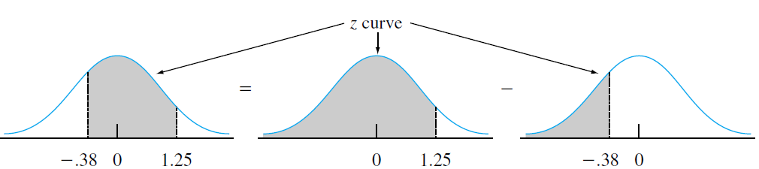
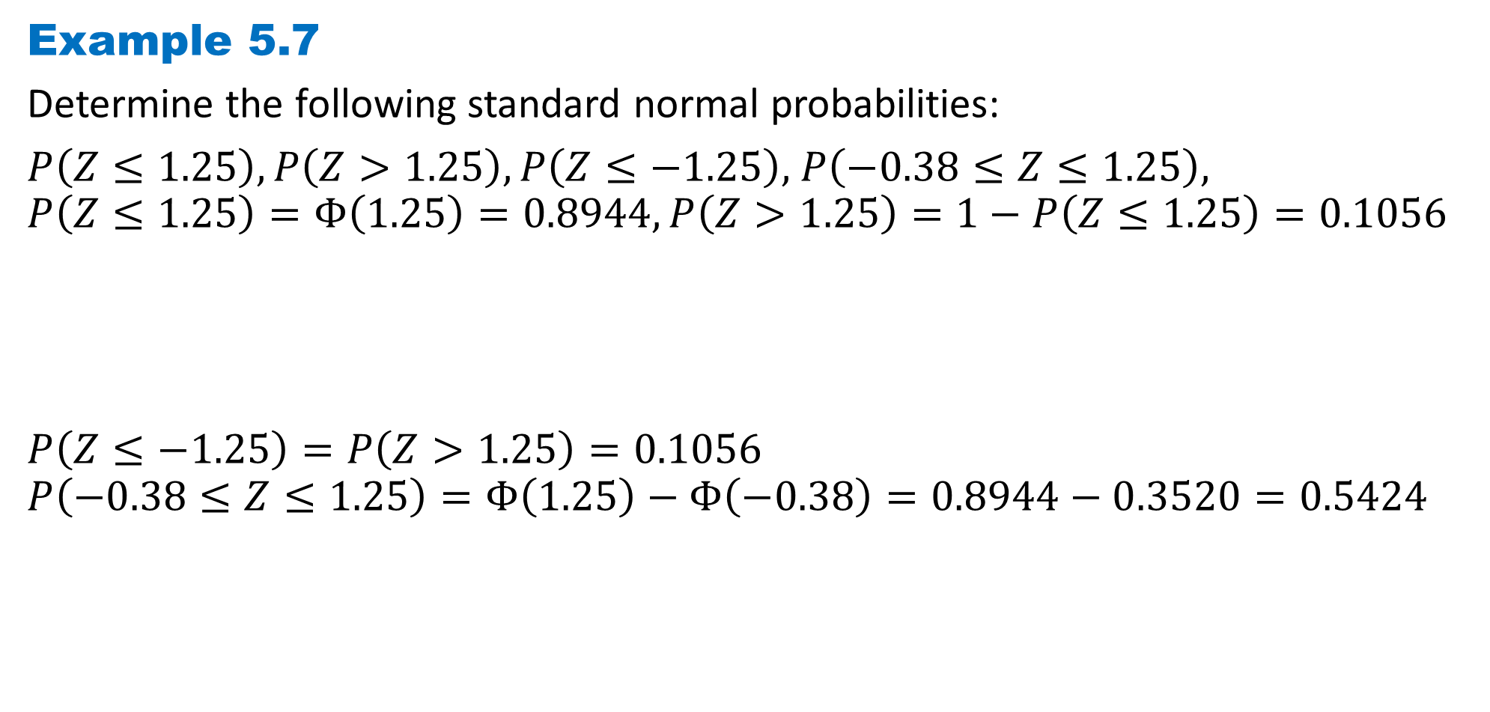
DLI
Example 5.7
Determine the following standard normal probabilities:
$P\left(Z≤1.25\right),P\left(Z>1.25\right),P\left(Z≤−1.25\right),$ $P\left(−0.38≤Z≤1.25\right),$
$$P\left(Z≤1.25\right)=Φ\left(1.25\right)=0.8944, P\left(Z>1.25\right)=1−P\left(Z≤1.25\right)=0.1056$$
$$P\left(Z≤−1.25\right)=P\left(Z>1.25\right)=0.1056$$
$$P\left(−0.38≤Z≤1.25\right)=Φ\left(1.25\right)−Φ\left(−0.38\right)=0.8944−0.3520=0.5424$$

Slide 30
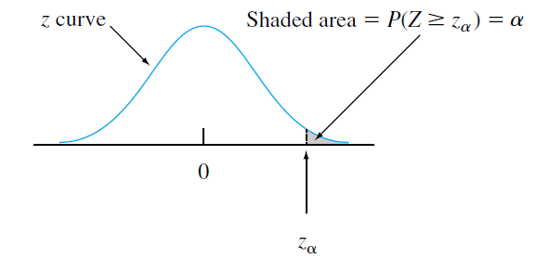
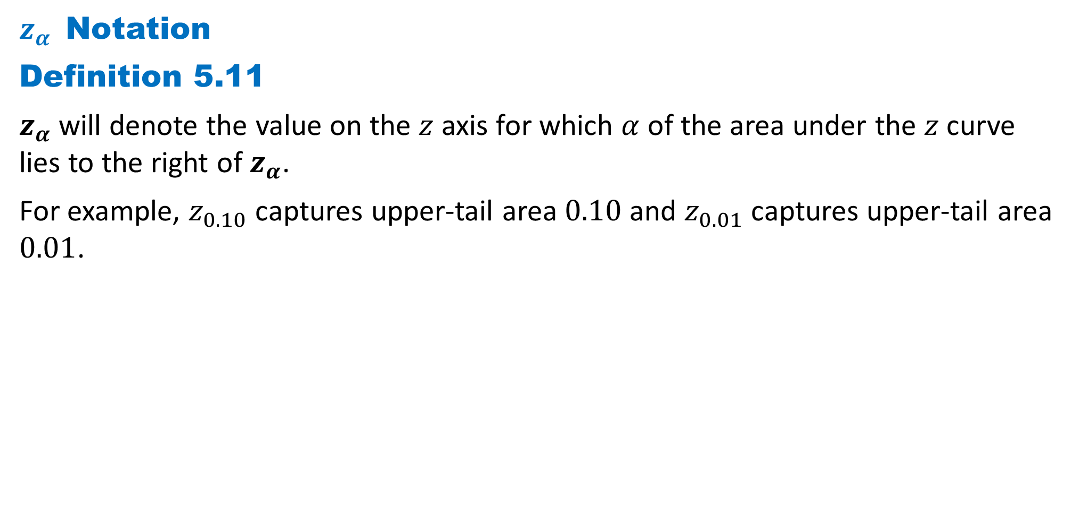
DLI
$z_{α}$Notation
Definition 5.11
$z_{α}$ will denote the value on the $z$ axis for which $α$ of the area under the $z$ curve lies to the right of $z_{α}$.
For example, $z_{0.10}$ captures upper-tail area $0.10$and $z_{0.01}$ captures upper-tail area $0.01$.

Slide 31
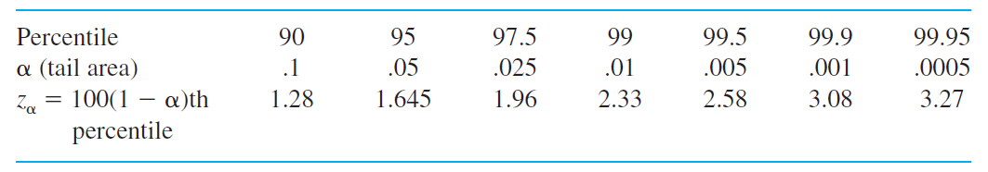
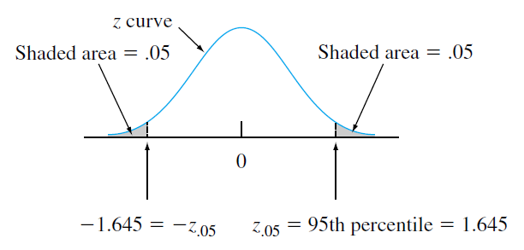

DLI
Standard Normal Percentiles and Critical Values
Since $α$ of the area under the $z$ curve lies to the right of $z_{α}$, $1−α$ of the area lies to its left. Thus $z_{α}$ is the $100(1−α)$th percentile of the standard normal distribution.
By symmetry the area under the standard normal
curve to the left of ${−z}_{α}$ is also $α$. The $z_{α}$s are
usually referred to as $z$ critical values.

Slide 32
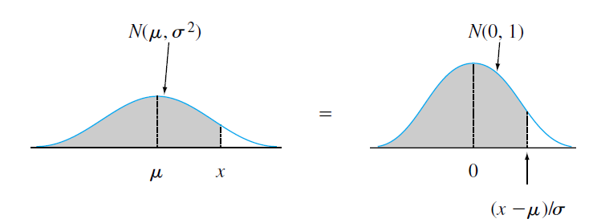
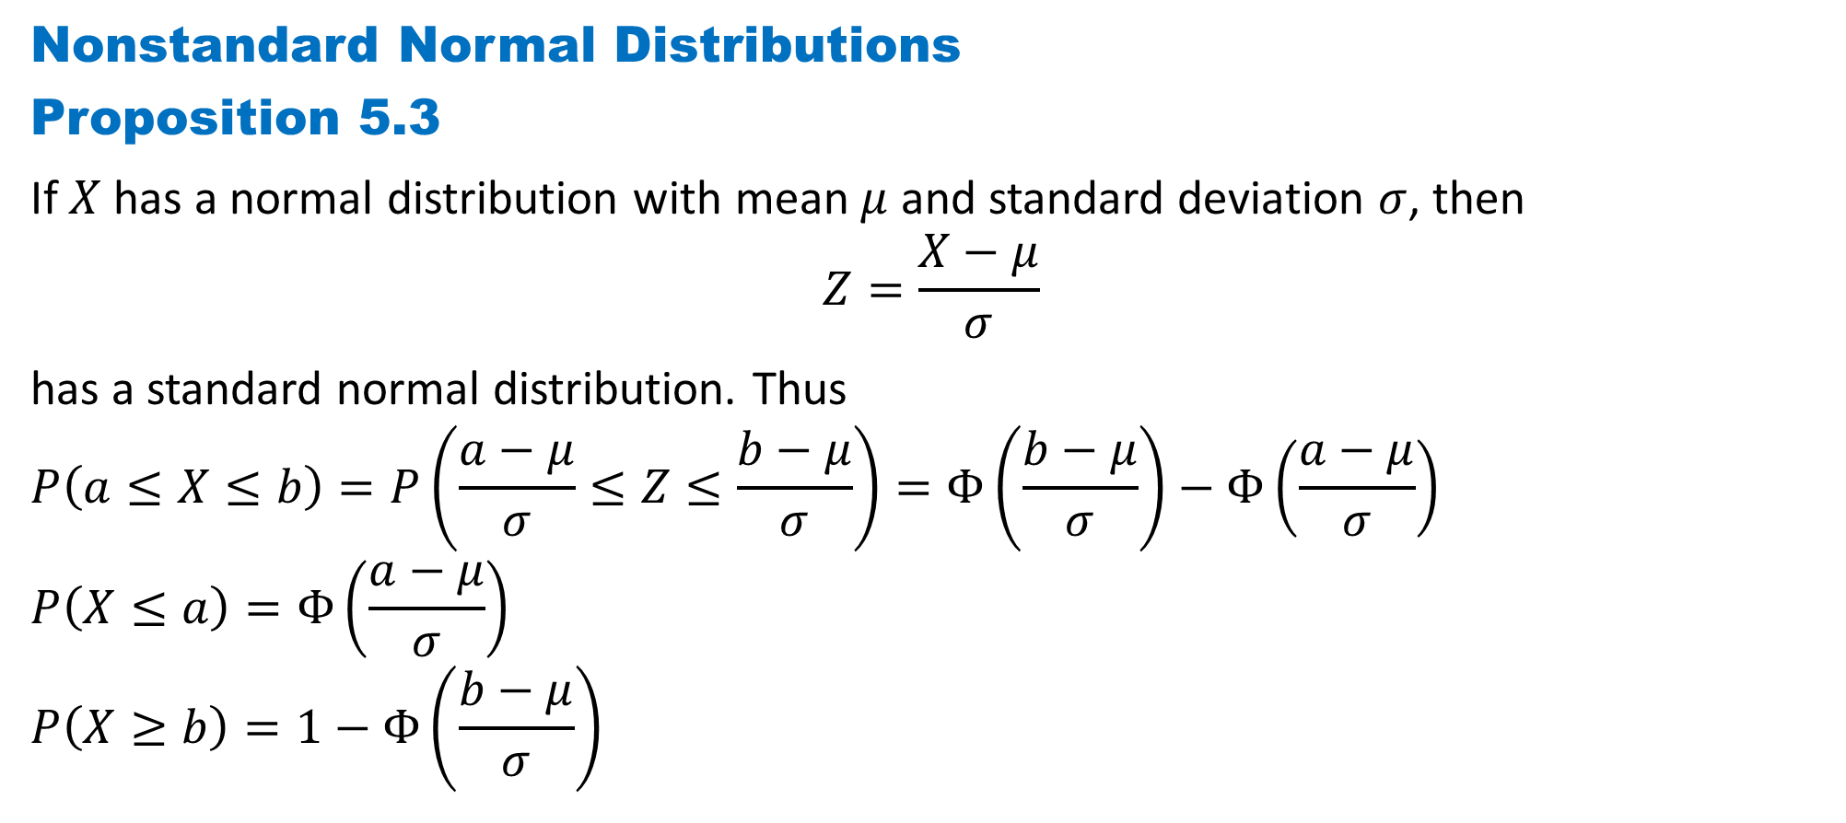
DLI
Nonstandard Normal Distributions
Proposition 5.3
If $X$ has a normal distribution with mean $μ$ and standard deviation $σ$, then
$$Z=\frac{X−μ}{σ}$$
has a standard normal distribution. Thus
$$P\left(a≤X≤b\right)=P\left(\frac{a−μ}{σ}≤Z≤\frac{b−μ}{σ}\right)=Φ\left(\frac{b−μ}{σ}\right)−Φ\left(\frac{a−μ}{σ}\right)$$
$$P\left(X≤a\right)=Φ\left(\frac{a−μ}{σ}\right)$$
$$P\left(X≥b\right)=1−Φ\left(\frac{b−μ}{σ}\right)$$

Slide 33
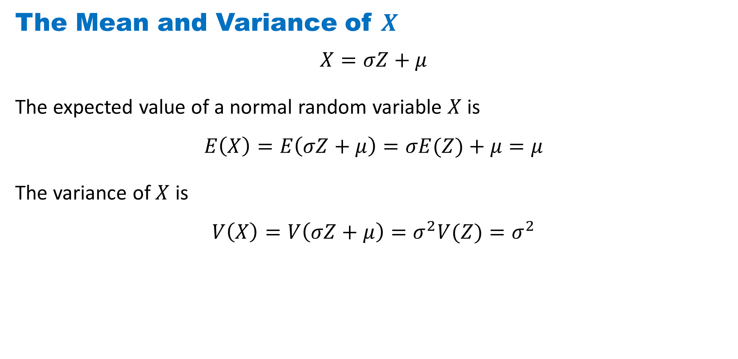
DLI
The Mean and Variance of $X$
$$X=σZ+μ$$
The expected value of a normal random variable $X$ is
$$E\left(X\right)=E\left(σZ+μ\right)=σE(Z)+μ=μ$$
The variance of $X$ is
$$V\left(X\right)=V\left(σZ+μ\right)=σ^{2}V(Z)=σ^{2}$$

Slide 34
DLI
The empirical rule
If the population distribution of a variable is (approximately) normal, then
1. Roughly 68% of the values are within 1 SD of the mean.
2. Roughly 95% of the values are within 2 SDs of the mean.
3. Roughly 99.7% of the values are within 3 SDs of the mean.

Slide 35
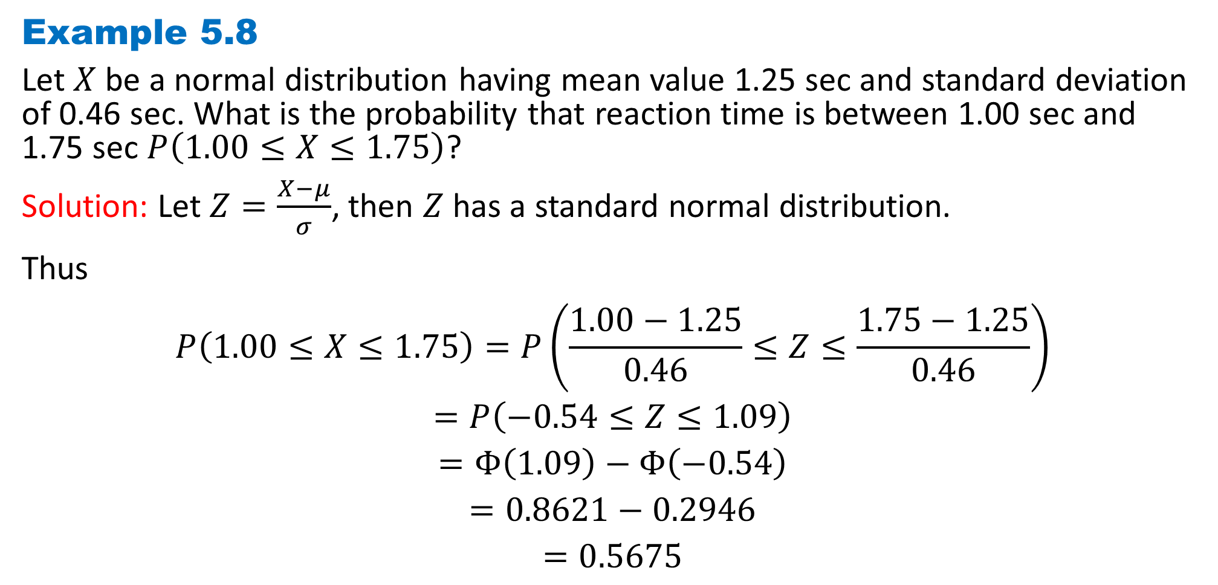
DLI
Example 5.8
Let $X$ be a normal distribution having mean value 1.25 sec and standard deviation of 0.46 sec. What is the probability that reaction time is between 1.00 sec and 1.75 sec $P\left(1.00≤X≤1.75\right)$?
Solution: Let $Z=\frac{X−μ}{σ}$, then $Z$has a standard normal distribution.
Thus
$$P\left(1.00≤X≤1.75\right)=P\left(\frac{1.00−1.25}{0.46}≤Z≤\frac{1.75−1.25}{0.46}\right)$$
$$=P\left(−0.54≤Z≤1.09\right)$$
$$=Φ\left(1.09\right)−Φ\left(−0.54\right)$$
$$=0.8621−0.2946$$
$$=0.5675$$

Slide 36
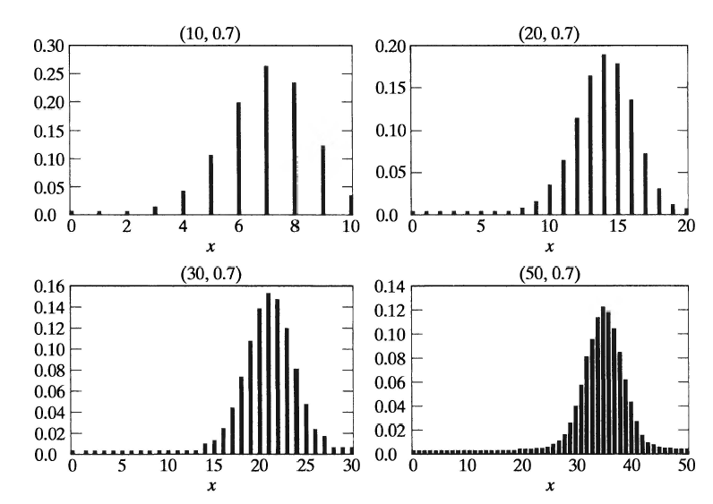
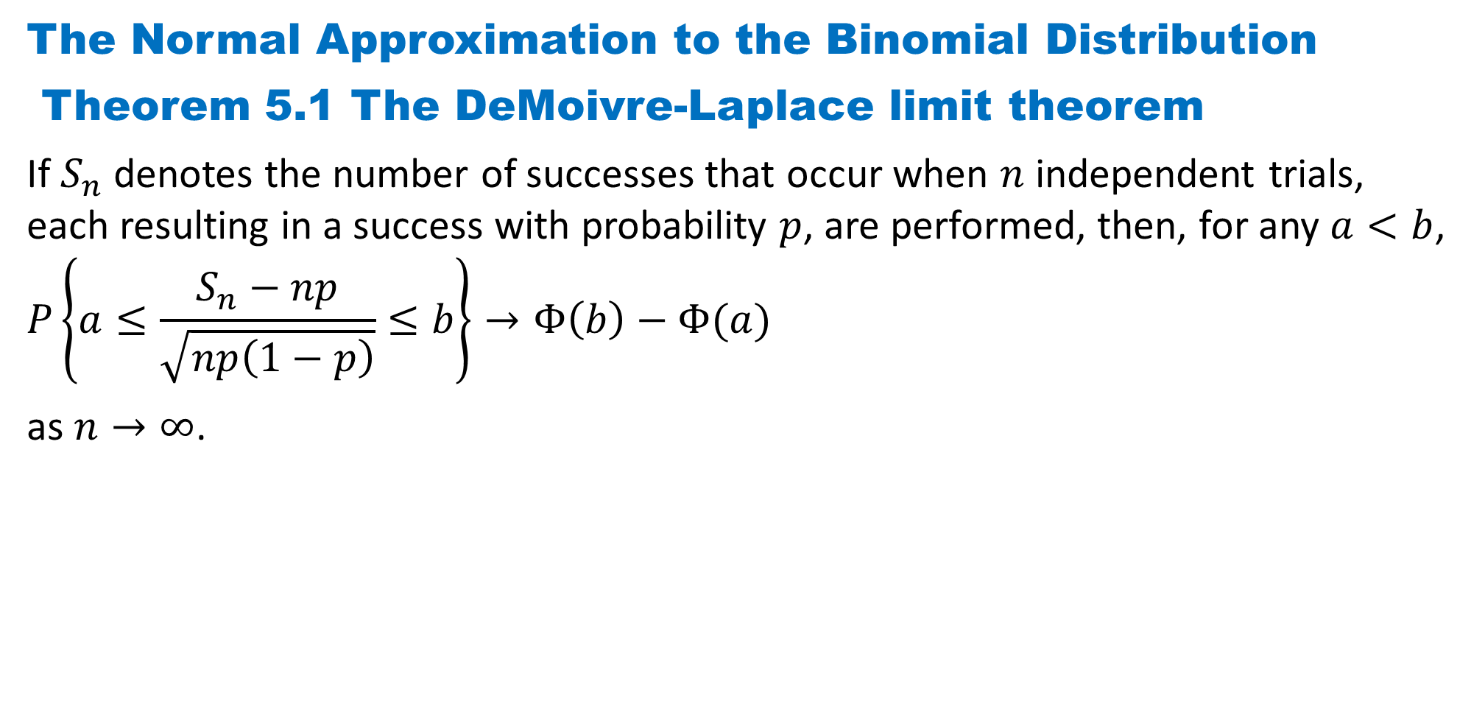
DLI
The Normal Approximation to the Binomial Distribution
Theorem 5.1 The DeMoivre-Laplace limit theorem
If $S_{n}$ denotes the number of successes that occur when $n$ independent trials, each resulting in a success with probability $p$, are performed, then, for any $a<b$,
$$P\left\{a≤\frac{S_{n}−np}{\sqrt{np\left(1−p\right)}}≤b\right\}→Φ\left(b\right)−Φ(a)$$
as $n→∞$.

Slide 37


DLI
Definition 5.12 The Exponential Distribution（指数分布）
$X$ is said to have an exponential distribution with parameter $λ(λ>0)$if the pdf of $X$ is
$$f(x;λ)=\left\{\begin{aligned}λe^{−λx} x≥0 \\ 0 otherwise\end{aligned}\right.$$
Some sources write the exponential pdf
in the form $\frac{1}{β}e^{−\frac{x}{β}}$, so that $β=\frac{1}{λ}$.
The exponential cdf is
$$F(x;λ)=\left\{\begin{aligned}1−e^{−λx} x≥0 \\ 0 x<0\end{aligned}\right.$$

Slide 38

DLI
The Mean and Variance of $X$
The expected value of an exponentially distributed random variable 𝑋 is
$$E\left(X\right)=\int_{0}^{+∞}{xλe^{−λx}dx}=−xe^{−λx}|_{0}^{+∞}+\int_{0}^{+∞}{e^{−λx}dx}={−\frac{1}{λ}e}^{−λx}|_{0}^{+∞}=\frac{1}{λ}$$
The variance of $X$ can be computed using the fact that
$$V\left(X\right)=E\left[X^{2}\right]−{\left[E\left(X\right)\right]}^{2}=\int_{0}^{+∞}{x^{2}λe^{−λx}dx}−\frac{1}{λ^{2}}$$
$$={−x}^{2}e^{−λx}|_{0}^{+∞}+\int_{0}^{+∞}{2xe^{−λx}dx}−\frac{1}{λ^{2}}$$
$$=0+\frac{2}{λ^{2}}−\frac{1}{λ^{2}}=\frac{1}{λ^{2}}$$
Both the mean and standard deviation of the exponential distribution equal $\frac{1}{λ}$.

Slide 39

DLI
The “memoryless” property of the exponential distribution
Example 5.9（指数分布的无记忆性）
Suppose component lifetime is exponentially distributed with parameter $λ$. After putting the component into service, we leave for a period of $t_{0}$ hours and then return to find the component still working; what now is the probability that it lasts at least an additional $t$ hours?
$$P\left(X≥t+t_{0}|X≥t_{0}\right)=\frac{P[\left(X≥t+t_{0})∩(X≥t_{0}\right)]}{P\left(X≥t_{0}\right)}$$
$$=\frac{P\left(X≥t+t_{0}\right)}{P\left(X≥t_{0}\right)}=\frac{1−F(t+t_{0};λ)}{1−F(t_{0};λ)}=\frac{1−(1−e^{−λ(t+t_{0})})}{1−(1−e^{−λt_{0}})}$$
$$=\frac{e^{−λ(t+t_{0})}}{e^{−λt_{0}}}=e^{−λt}=P\left(X≥t\right)$$

Slide 40

DLI
Other Continuous Distributions
Definition 5.13 The Gamma Distribution（伽马分布）
A random variable is said to have a gamma distribution with parameters $(α, λ), λ>0$,$α>0$, if its density function is given by
$$f(x;α,λ)=\left\{\begin{aligned} \frac{λe^{−λx}{\left(λx\right)}^{α−1}}{Γ(α)} x≥0 \\ 0 otherwise\end{aligned}\right.$$
where $Γ(α)$, called the gamma function, is defined as
$$Γ\left(α\right)=\int_{0}^{∞}{e^{−y}y^{α−1}dy}$$

Slide 41

DLI
Integration of $Γ(α)$ by parts yields
$$Γ\left(α\right)=−e^{−y}y^{α−1}|_{0}^{∞}+\int_{0}^{∞}{e^{−y}(α−1)y^{α−2}dy}$$
$$=(α−1)\int_{0}^{∞}{e^{−y}y^{α−2}dy}$$
$$=(α−1)Γ(α−1)$$
When $α=n$, $Γ\left(n\right)=(n−1)Γ(n−1)$
$$=(n−1)(n−2)Γ(n−2)$$
$$=(n−1)(n−2)⋯2Γ(1)$$
$Γ\left(1\right)=\int_{0}^{∞}{e^{−y}dy}=1$,
$$Γ\left(n\right)=\left(n−1\right)!$$

Slide 42

DLI
The Mean and Variance of gamma distribution
$$E\left(X\right)=\int_{0}^{+∞}{\frac{λxe^{−λx}{\left(λx\right)}^{α−1}}{Γ(α)}dx}=\frac{1}{λΓ(α)}\int_{0}^{+∞}{λe^{−λx}{\left(λx\right)}^{α}dx}=\frac{1}{λΓ(α)}\int_{0}^{+∞}{e^{−y}y^{α}dy}=\frac{Γ(α+1)}{λΓ(α)}=\frac{α}{λ}$$
The variance of $X$ can be computed using the fact that
$$E\left(X^{2}\right)=\int_{0}^{+∞}{\frac{λx^{2}e^{−λx}{\left(λx\right)}^{α−1}}{Γ(α)}dx}=\frac{1}{λ^{2}Γ(α)}\int_{0}^{+∞}{λe^{−λx}{\left(λx\right)}^{α+1}dx}=\frac{1}{λ^{2}Γ(α)}\int_{0}^{+∞}{e^{−y}y^{α+1}dy}=\frac{Γ(α+2)}{λ^{2}Γ(α)}=\frac{α(α+1)}{λ^{2}}$$
$$V\left(X\right)=E\left[X^{2}\right]−{\left[E\left(X\right)\right]}^{2}=\frac{α(α+1)}{λ^{2}}−\frac{α^{2}}{λ^{2}}=\frac{α}{λ^{2}}$$

Slide 43

DLI
Definition 5.13 The Cauchy Distribution（柯西分布）
A random variable is said to have a Cauchy distribution with parameters $θ$,
$−∞<θ<+∞$, if its density function is given by
$$f\left(x;θ\right)=\frac{1}{π}\frac{1}{1+{\left(x−θ\right)}^{2}}, −∞<x<+∞$$
The distribution function of $X$ is thus given by
$$F\left(x\right)=\frac{1}{2}+\frac{1}{π}arctan⁡(x−θ)$$

Slide 44

DLI
The Distribution of a Function of a Random Variable
Often, we know the probability distribution of a random variable and are interested in determining the distribution of some function of it. For instance, suppose that we know the distribution of $X$ and want to find the distribution of $g(X).$

Slide 45

DLI
Example 5.10
Let $X$ be uniformly distributed over $(0, 1).$We obtain the distribution of the random variable $Y$, defined by $Y=X^{n}$, as follows:
For $0≤y≤1$,
$$F_{Y}\left(y\right)=P\left\{Y≤y\right\}=P\left\{X^{n}≤y\right\}=P\left\{X≤y^{\frac{1}{n}}\right\}=y^{\frac{1}{n}}$$
So the distribution of the random variable $Y$is $F_{Y}\left(y\right)=\left\{\begin{matrix}0, y<0 \\ y^{\frac{1}{n}}, 0≤y≤1 \\ 1, y>1\end{matrix}\right.$
The density function of $Y$ is given by $f_{Y}\left(y\right)=F_{Y}^{′}\left(y\right)=\left\{\begin{aligned}\frac{1}{n}y^{\frac{1−n}{n}},0≤y≤1 \\ 0, otherwise\end{aligned}\right.$

Slide 46

DLI
Example 5.11
If $X$ is a continuous random variable with probability density $f_{X}$, then the distribution of $Y=X^{2}$is obtained as follows:
For $y≥0$,
$$F_{Y}\left(y\right)=P\left\{Y≤y\right\}=P\left\{X^{2}≤y\right\}=P\left\{−\sqrt{y}≤X≤\sqrt{y}\right\}=F_{X}\left(\sqrt{y}\right)−F_{X}\left(−\sqrt{y}\right)$$
Differentiation yields
$$f_{Y}\left(y\right)=F_{Y}^{′}\left(y\right)=\frac{1}{2\sqrt{y}}[f_{X}\left(\sqrt{y}\right)+f_{X}\left(−\sqrt{y}\right)]$$

Slide 47

DLI
Theorem 5.2
Let $X$ be a continuous random variable having probability density function $f_{X}$. Suppose that $g(x)$is a strictly monotonic (increasing or decreasing), differentiable (and thus continuous) function of $x$. Then the random variable $Y$ $f_{Y}\left(y\right)=\left\{\begin{aligned}f_{X}\left(g^{−1}(y)\right)\left|\frac{d }{dy}g^{−1}(y)\right|, if y=g\left(x\right)for some x \\ 0，if y≠g(x) for all x\end{aligned}\right.$
where $g^{−1}(y)$ is defined to equal that value of $x$ such that $g(x)=y$.

Slide 48

DLI
Proof: When $g(x)$is an increasing function.
Suppose that $y=g(x)$for some $x$. Then, with $Y=g(X),$
$$F_{Y}\left(y\right)=P\left(Y≤y\right)=P\left(g(X)≤y\right)$$
$$=P\left(X≤g^{−1}\left(y\right)\right)=F_{X}\left(g^{−1}\left(y\right)\right)$$
Differentiation gives
$$f_{Y}\left(y\right)= f_{X}\left(g^{−1}(y)\right)\frac{d }{dy}g^{−1}(y)$$
Since $g^{−1}\left(y\right)$ is nondecreasing, so its derivative is nonnegative.
When $y≠g(x)$for any $x$, then $F_{Y}(y)$ is either $0$ or $1$, and in either case
$f_{Y}\left(y\right)=0$.

Slide 49

DLI
When $g(x)$is an decreasing function.
Suppose that $y=g(x)$for some $x$. Then, with $Y=g(X),$
$$F_{Y}\left(y\right)=P\left(Y≤y\right)=P\left(g(X)≤y\right)$$
$$=P\left(X≥g^{−1}\left(y\right)\right)=1−F_{X}\left(g^{−1}\left(y\right)\right)$$
Differentiation gives
$$f_{Y}\left(y\right)=−f_{X}\left(g^{−1}(y)\right)\frac{d }{dy}g^{−1}(y)$$
Since $g^{−1}\left(y\right)$ is decreasing, so its derivative is negative.
$$f_{Y}\left(y\right)=f_{X}\left(g^{−1}(y)\right)\left|\frac{d }{dy}g^{−1}(y)\right|$$
When $y≠g(x)$for any $x$, then $F_{Y}(y)$ is either $0$ or $1$, and in either case
$f_{Y}\left(y\right)=0$.

Slide 50
DLI
Homework
Page 227 Problems
1, 7, 13, 14, 15, 33, 40
Page 229 Theoretical Exercises
9, 20
Page 232 Self-Test Problems and Exercises
2, 4, 10, 13, 16

